Slide 1
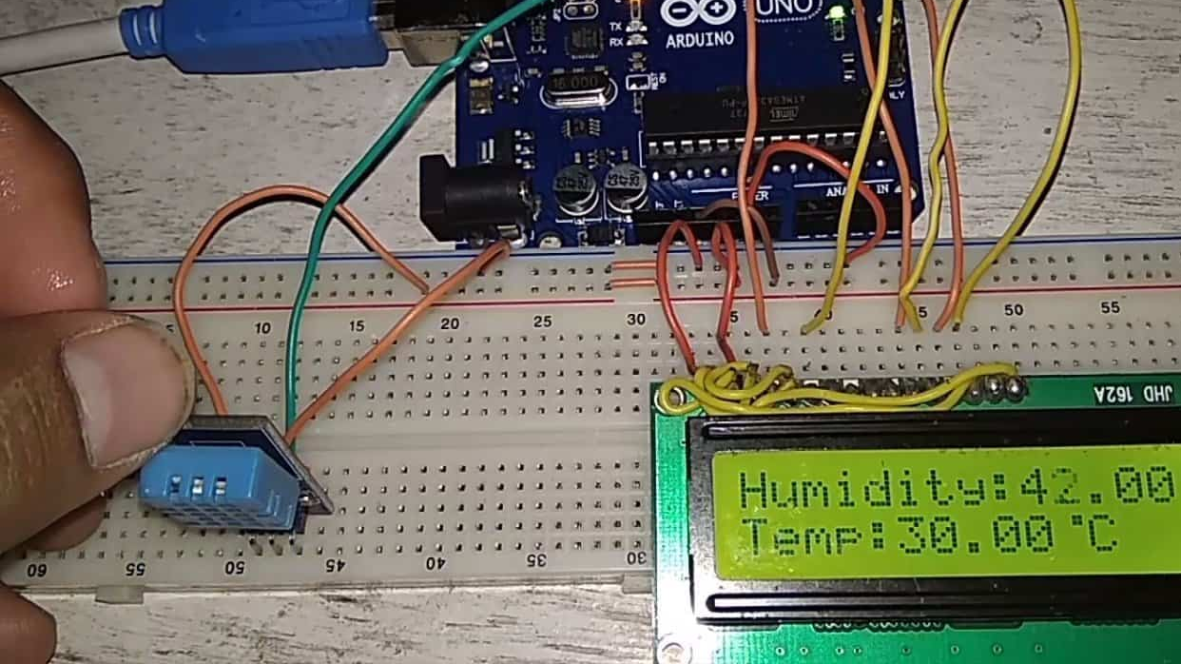
The Embedded System Capstone Project The Problem Statement… Temperature and Humidity Monitoring over Thing Speak using Arduino UNO and ESP8266 An LCD screen can be connected to the Arduino to display the current temperature and humidity readings in real-time.

Slide 2


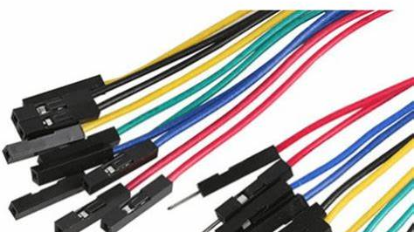



Introduction :
In this project, we are using the DHT11 sensor for sending Temperature and Humidity data to ThingSpeak using Arduino and ESP8266. By this method, we can monitor our DHT11 sensor’s temperature and humidity data over the internet using the ThingSpeak server. And we can view the logged data and graph overtime on the Thingspeak website.
Here Arduino Uno reads the current temperature and humidity data from DHT11 and sends it to the ThingSpeak server for live monitoring from anywhere in the world. upload the data on the cloud. ThingSpeak is an open data platform for monitoring your data online where you can set the data as private or public according to your choice. ThingSpeak takes a minimum of 15 seconds to update your readings.

Slide 3
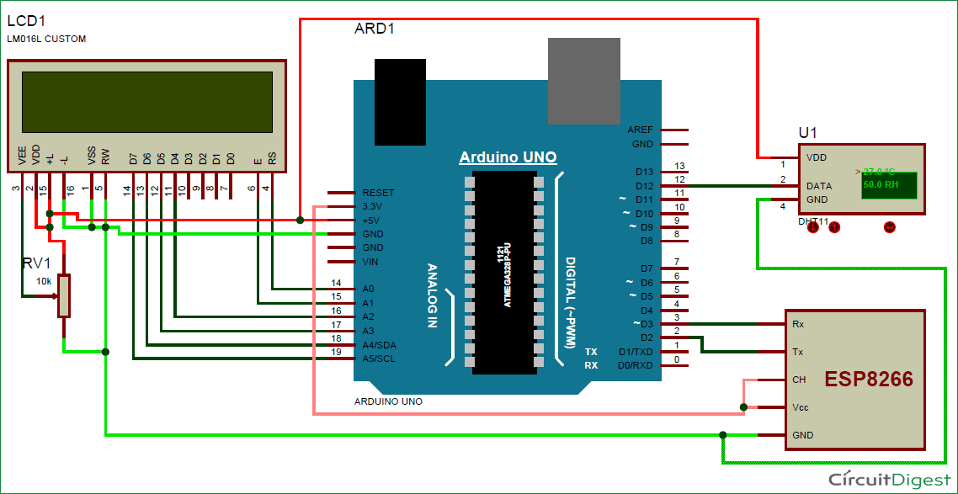
Circuit Diagram and Explanation
Monitor Humidity and Temperature over the internet using ThingSpeak where we will show the current Humidity & Temperature data over the Internet using the ThingSpeak server. It is accomplished by the data communications between Arduino, DHT11 Sensor Module, ESP8266 WIFI module and LCD. Celsius scale thermometer and percentage scale humidity meter displays the ambient temperature and humidity through a LCD display and also sends it to ThingSpeak server for live monitoring from anywhere in the world.

Slide 4
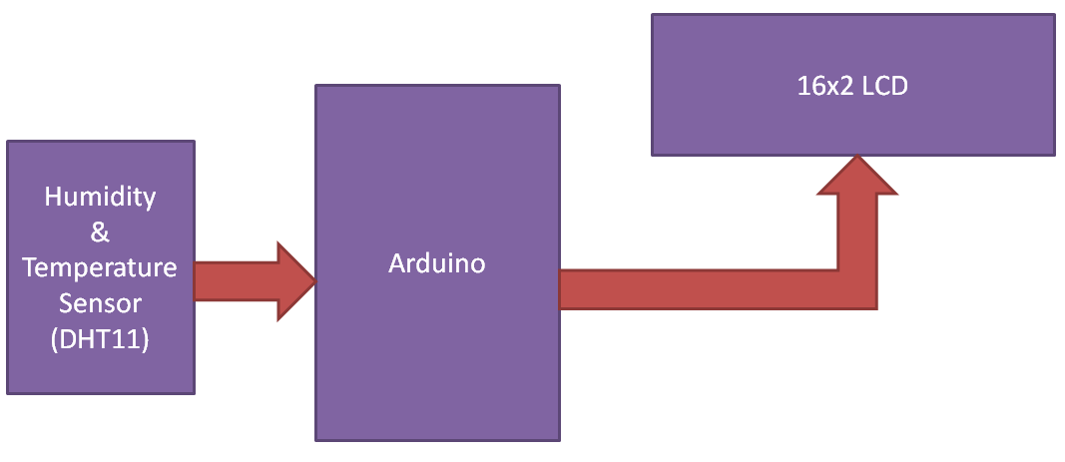
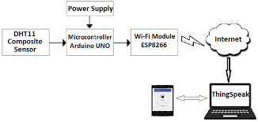
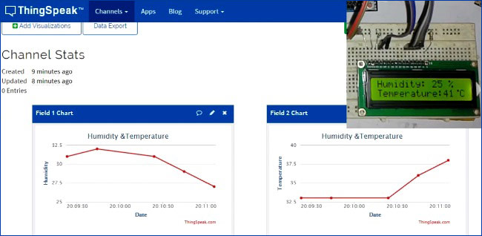
DHT11 Humidity + Temperature Sensor with 16x2 LCD display + ESP8266 Wi-Fi Module - ThingSpeak web Platform

Slide 5
Project Description
Proposed Solution:
This project constructs an environmental data logger using an Arduino microcontroller board. The system utilizes sensors to measure ambient temperature and humidity. The sensor readings, initially in analog voltage format, are processed by the Arduino and converted into standard units of Celsius for temperature and percent relative humidity. The project offers functionalities for both local and remote monitoring.
Remote Monitoring:
The Arduino communicates wirelessly with a web platform called Thingspeak via an ESP8266 Wi-Fi module. This enables the transmission of collected temperature and humidity data to Thingspeak. Users can then access this data remotely from any device with an internet connection, allowing for convenient monitoring and analysis of environmental conditions over time. This remote access empowers users to make informed decisions regarding potential adjustments to their environment based on the collected data.

Slide 6
Temperature and Humidity Monitoring over ThingSpeak using Arduino UNO and ESP8266
In this project, we are using the DHT11 sensor for sending Temperature and Humidity data to Thingspeak using Arduino and ESP8266. By this method, we can monitor our DHT11 sensor’s temperature and humidity data over the internet using the ThingSpeak IoT server. And we can view the logged data and graph overtime on the Thingspeak website.
Here Arduino Uno reads the current temperature and humidity data from DHT11 and sends it to the ThingSpeak server for live monitoring from anywhere in the world. We used ThingSpeak with ESP32 to upload the data on the cloud.
ThingSpeak is an open data platform for monitoring your data online where you can set the data as private or public according to your choice. ThingSpeak takes a minimum of 15 seconds to update your readings.

Slide 7
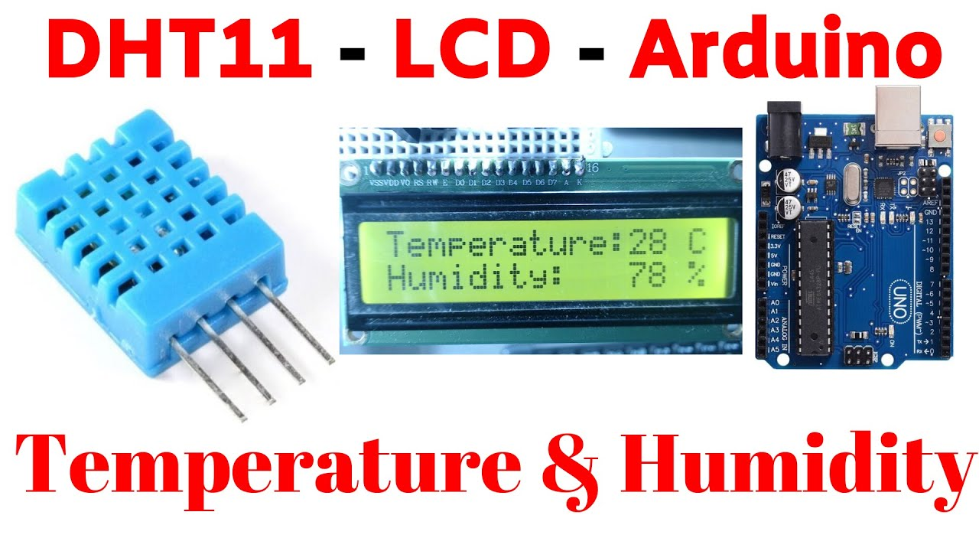
Hardware Setup:
Components:
Arduino Uno
DHT11 sensor (for temperature and humidity)
LCD 16x2
Bread Board
ESP8266 Wi-Fi module
jumper wires

Slide 8
The Project Implementation : Steps
2. Software Configuration:
Install the necessary libraries for the DHT sensor and the LCD display in Arduino IDE.
Set up the ESP8266 to connect to your Wi-Fi network.
Configure the ThingSpeak platform to receive data from your Arduino.
3. Arduino Code:
Read temperature and humidity data from the DHT sensor.
Display the data on the LCD screen.
Send the data to ThingSpeak using the ESP8266.
1. Hardware Setup:
Need an Arduino UNO
Connect a DHT11 temperature and humidity sensor to the Arduino.
Wire up a 16x2 LCD display to the Arduino.
Use an ESP8266 Wi-Fi module for wireless communication.

Slide 9
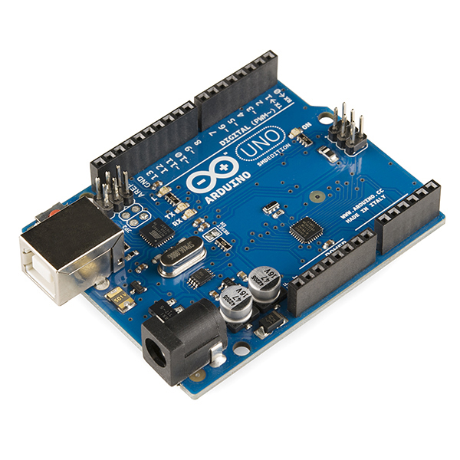
The Arduino UNO is a microcontroller board based on the ATmega328P. It has 14 digital input/output pins, 6 analog inputs, a 16 MHz quartz crystal, a USB connection, a power jack, an ICSP header, and a reset button. The Arduino UNO is programmed using the Arduino software (IDE), which is available for Windows, Mac, and Linux. The board can be powered by an external power supply or by USB. It is compatible with a wide range of sensors, actuators, and other devices, which can be connected to it using a variety of communication protocols, such as I2C, SPI, and UART. The Arduino UNO is a popular choice for beginners and hobbyists, as it is easy to use and has a large community of users and developers.
Arduino UNO :

Slide 10
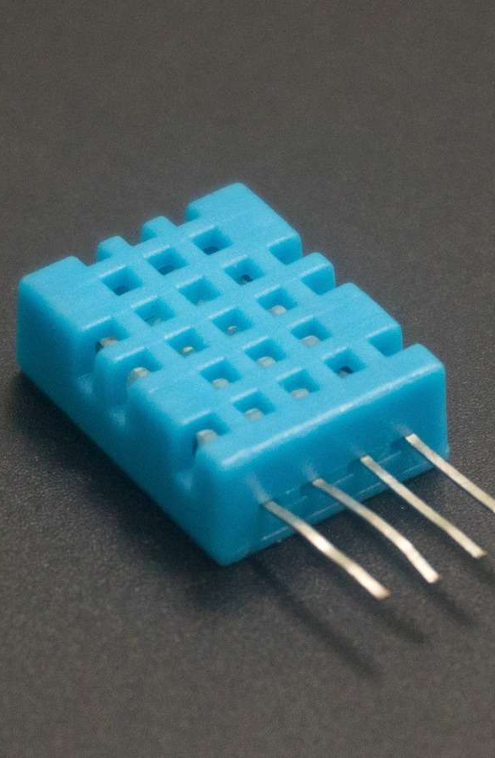
The DHT11 sensor operates by utilizing a thermistor to measure temperature and a humidity-sensitive capacitor to gauge the relative humidity in the surrounding environment. When connected to an Arduino board, the sensor sends digital signals that can be interpreted to obtain accurate readings of both temperature and humidity levels. Temperature and Humidity by using DHT11 with Arduino. Here we also display those readings on an LCD Display. need to install the below DHT11 library. Just download the below library and open Arduino IDE. Now go to Sketch > Include Library > Add .Zip Library.
DHT11 Sensor :

Slide 11
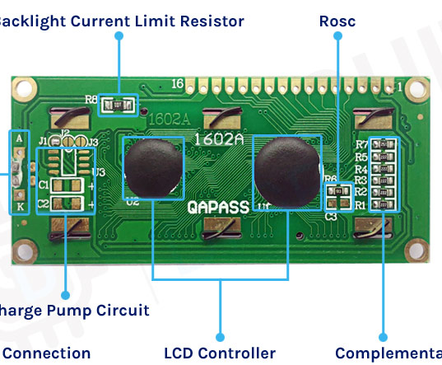
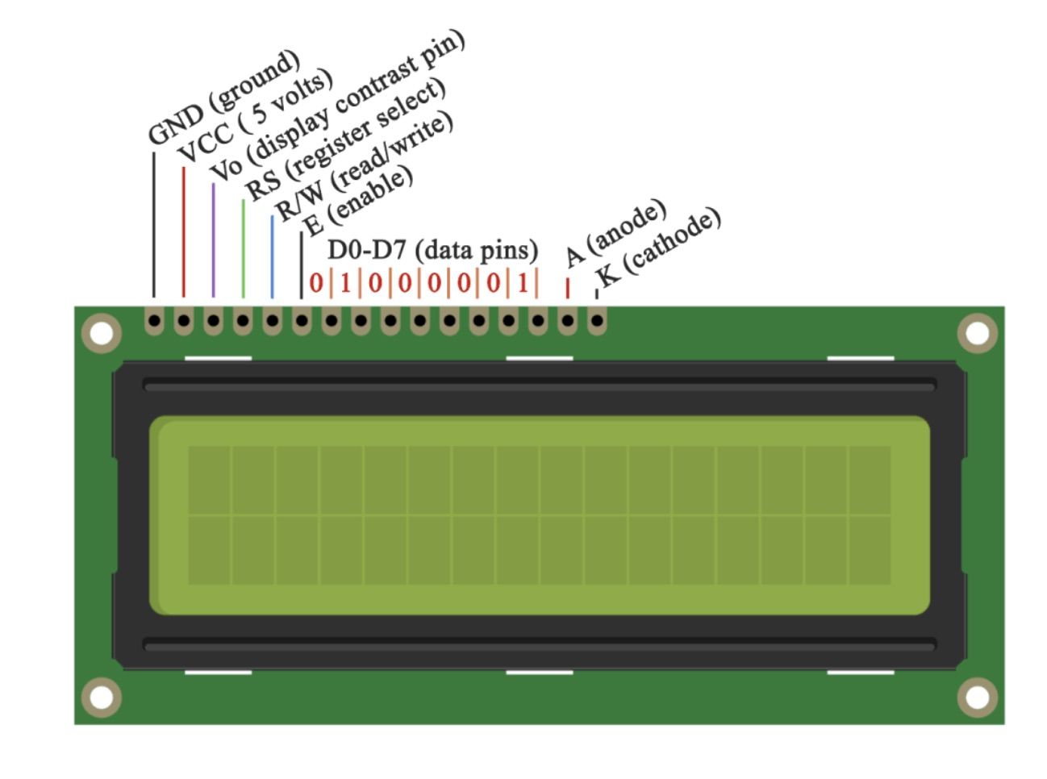
LCD Display 16x2 The interface consists of the following pins: A register select (RS) pin that controls where in the LCD's memory you're writing data to. You can select either the data register, which holds what goes on the screen, or an instruction register, which is where the LCD's controller looks for instructions on what to do next. 8 data pins (D0 -D7). The states of these pins (high or low) are the bits that you're writing to a register when you write, or the values you're reading when you read.

Slide 12
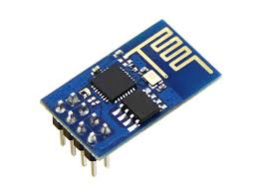
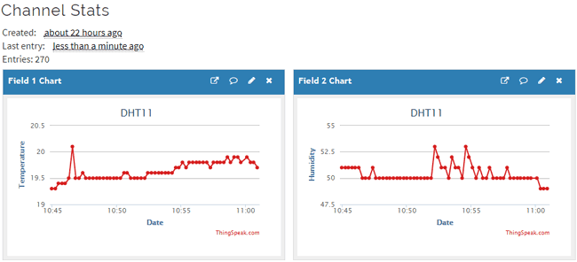
First, it will get connected to the WiFi Network. Then, immediately, it will try to read the data from the DHT11 Humidity sensor and calculate the Temperature and Humidity values based on that data. After this, the values of temperature and humidity will be uploaded to the ThingSpeak API. If you open your channel in the ThingSpeak, you caan see the chart associated with the values from the DHT11 Sensor.
ESP8266 Wi-Fi Module

Slide 13
S.NO. | Pin Name | Arduino Pin
1 | ESP8266 VCC | 3.3V
2
3 | ESP8266 CH-PD | 3.3V
4 | ESP8266 RX | RX
5 | ESP8266 TX | TX
6 | ESP8266 GND | GND
7 | DHT-11 VCC | 5V
8 | DHT-11 Data | 5
9 | DHT-11 GND | GND
Connections Pins :

Slide 14
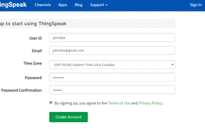
Step 1: ThingSpeak Setup for Temperature and Humidity Monitoring .
For creating your channel on Thing speak, you first need to Sign up on Thing speak. In case if you already have an account on Things peak, just sign in using your id and password. For creating your account go to www.thinspeak.com

Slide 15
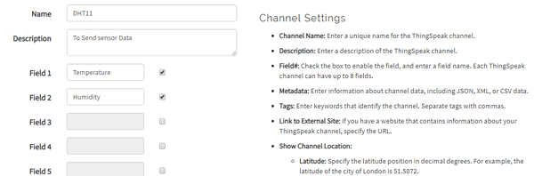
Step 2: Create a Channel for Your Data Once you Sign in after your account verification, Create a new channel by clicking “New Channel” button
After clicking on “New Channel”, enter the Name and Description of the data you want to upload on this channel. For example, I am sending my DHT11 sensor data, so I named it DHT11 data.

Slide 16
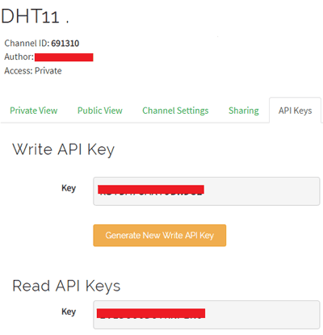
Step 3: API Key
To send data to Thingspeak, we need a unique API key, which we will use later in our code to upload our sensor data to Thingspeak Website.

Slide 17
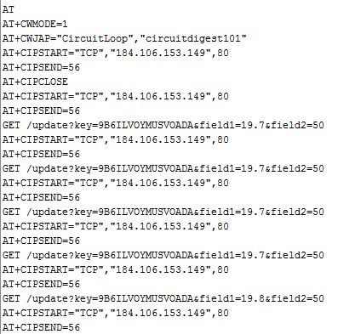
Programming Arduino for Sending data to ThingSpeak To program Arduino, open Arduino IDE and choose the correct board and port from the ‘tool’ menu.
Upload it in Arduino UNO. If you successfully upload your program, Serial monitor will look like this:
After this navigate to your Thingspeak page and open your channel at Thingspeak and output will be shown as below:
we have successfully monitored Temperature and Humidity data over ThingSpeak using Arduino an ESP32.

Slide 18
The Embedded System Capstone Project Thank & Regards

